Slide 1








Skin Disease Detection Using CNN
Guide: Prof. Vikrant Agaskar Sir

Slide 2
Introduction
Overview: A deep learning-based approach for detecting skin diseases from images.
Importance: Early and accurate diagnosis of skin conditions can improve treatment outcomes.
Problem Statement: Manual diagnosis is prone to errors and lacks accessibility in remote areas.

Slide 3
Importance of the Project
Provides an automated, accurate diagnostic tool.
Reduces dependency on dermatologists in remote areas.
Helps in early diagnosis, improving patient outcomes.

Slide 4



Objectives
Develop a CNN model to classify skin diseases from images.
Preprocess image data to improve prediction accuracy.
Integrate feature extraction and classification techniques.
Expected Outcomes:
1. High-accuracy detection model.
2. Visual insights into the classification process.

Slide 5
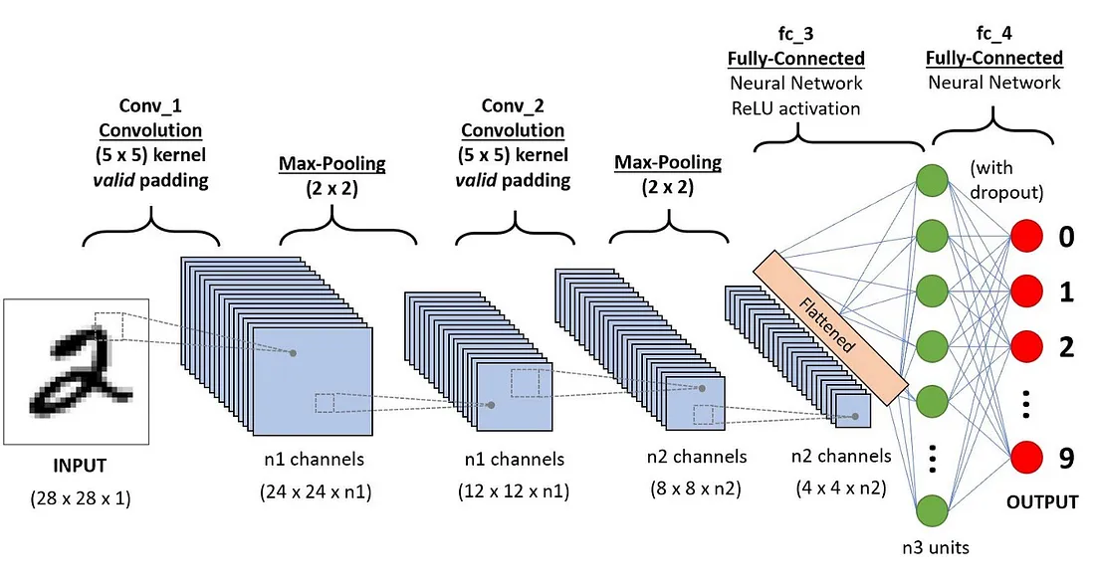
Basic Working of CNN

Slide 6
Methodology / System Architecture
01
02
03
04
05
Input
Preprocessing
Classification
Output
Feature Extraction
Modules:
1. Data Preprocessing: Augmentation, resizing, normalization.
2. Model Design: 5-layer CNN with dropout and batch normalization.
3. Training: Use of cross-entropy loss and accuracy metrics.

Slide 7
Tools and Technologies
Programming Languages: Python
Frameworks: TensorFlow/Keras
Libraries: NumPy, Matplotlib, Pandas
Hardware: GPU for accelerated training

Slide 8
Summary
CNN is a promising solution for automating skin disease detection.
With sufficient data, the model can match or exceed human accuracy.
Future Scope:
1. Expand the dataset to cover more diseases.
2. Develop a user-friendly mobile application.

Slide 9
Thanks!

